Slide 1
Money Matters Topic 2
Check Writing

Slide 2
Open a Checking Account
Go to bank or credit union and start an account. Recommend a no fee account.
You will receive a routing number and an account number. You should also get a debit card for this account. Open the account with a deposit amount so you can begin using the account. You can also order checks. They will have your name, address, routing number, and account number. You can order through your bank or via an online vendor. Can be plain or decorated.

Slide 3
Using the Checking Account
Once you have the account established and working, you can use is for deposits and withdrawals. Deposits can be done at the bank, ATM, online check cashing, or set-up through your employer. Withdrawals can be done at the ATM, a store that accepts debit cards, automatic transfers, and writing checks. Keep track using your transaction register and verify with monthly statements or online banking. Beware of over drafting your account. This will cost you money in the form of a penalty.

Slide 4
Writing Checks
Checks need a name or company to whom the check is written. You write this on the line where it reads “pay to the order of.” They also have a space for the date, a box in which you write the amount, and a line on which you write the amount using English words. That math lesson really was valuable! You also must sign the check and there is a space for you to record a memo for yourself.

Slide 5
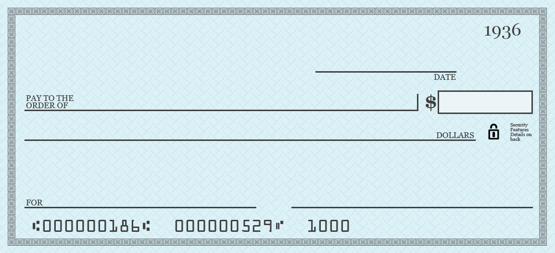
Example check

Slide 6
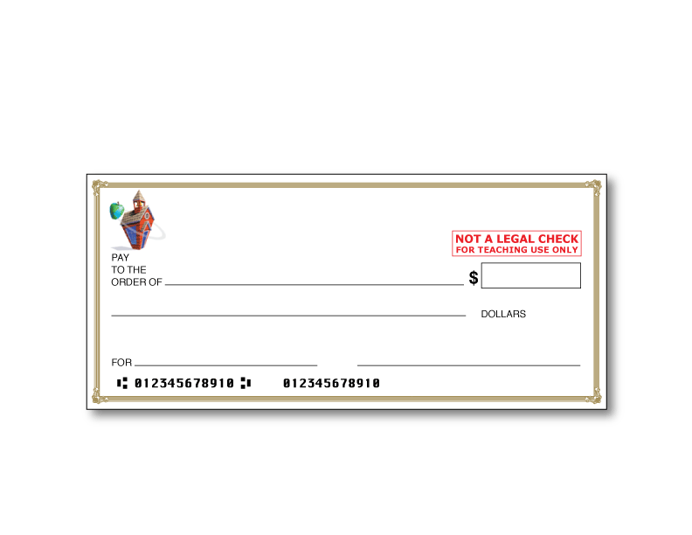
Sample Check
Notice this sample is missing the owner’s address, a line for the date and a check number. Your actual checks will include these items.

Slide 7
Write some example checks
Payable to PPL Electric Utilities for $128.56
Complete a student example.
Complete a transaction register example.

